Slide 1

Loan Data Analysis ETL Pipeline
George Ge

Slide 2

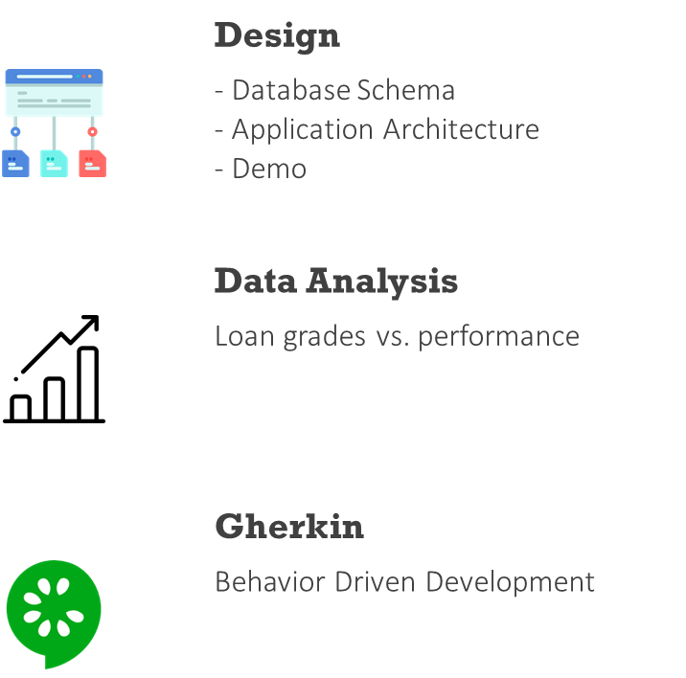
Agenda
Main points

Slide 3

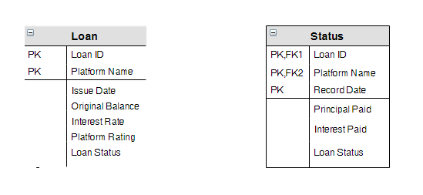
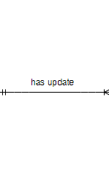

Database Schema

Slide 4
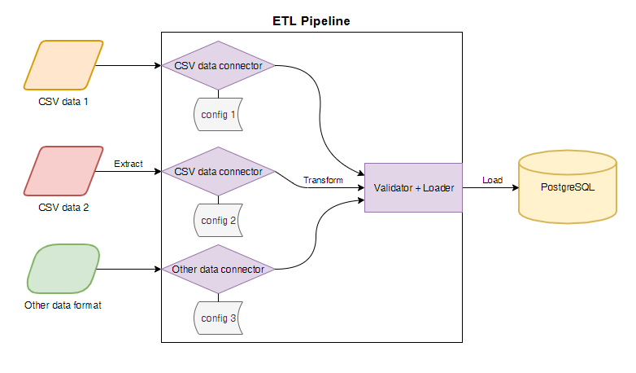
Application Architecture

Slide 5
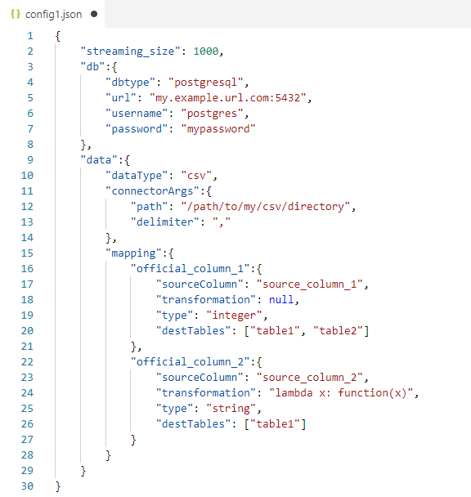
Configuration

Slide 6

Demo
We will run the ETL pipeline on a subset of the data in this demo.

Slide 7
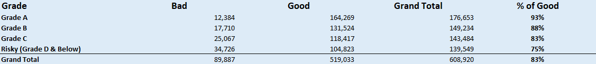
Data Analysis
How does the loan grade inform the performance of the loan?
12%
7%
93%
88%

Slide 8
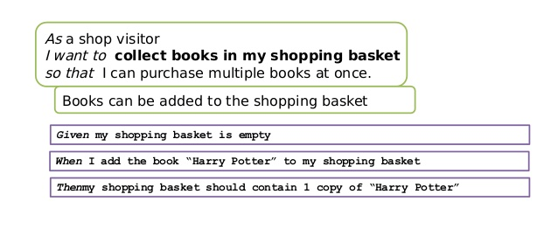
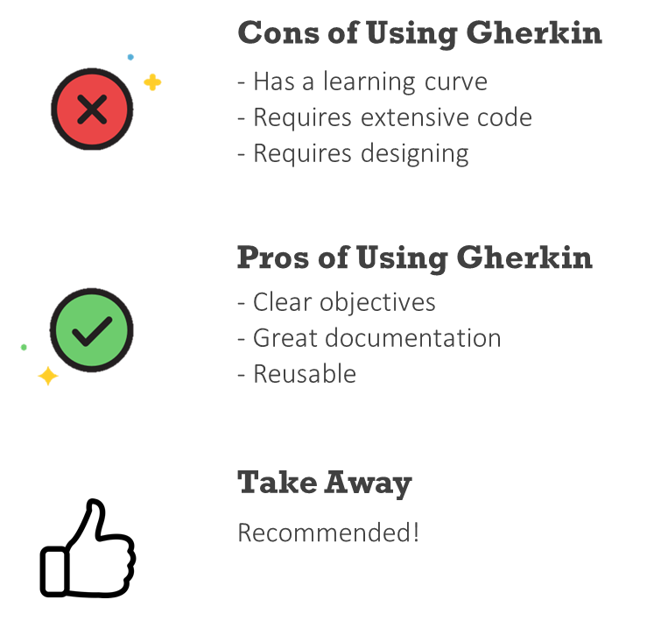
Behavior Driven Development ( Gherkin )

Slide 9





Thank You
George Ge
+1 908 601 3913
george.jiaqi.ge@gmail.com
https://www.linkedin.com/in/george-ge-1048073a

